Slide 1
Multi-Agent Path Finding
Simulation of manufacturing processes
Chembrolu Surya
Felipe Vianna
Yuu Sakaguchi

Slide 2
Problem
Find paths for each robot according to sequence of operations they should go to.
Avoid collision between robots

Slide 3
Given parameters
Grid map – As adjacent Matrix for paths calculations
Position sequences for each robot: Start, op1, op2, end
nodesWeights=[1 1 1 1 1 1 1 1 1 1 1 10 1 1 1 1 1 1 5 1 1 1 1 1 1]
ozo1seq=[1 12 19 4]
ozo2seq=[2 19 12 5]

Slide 4
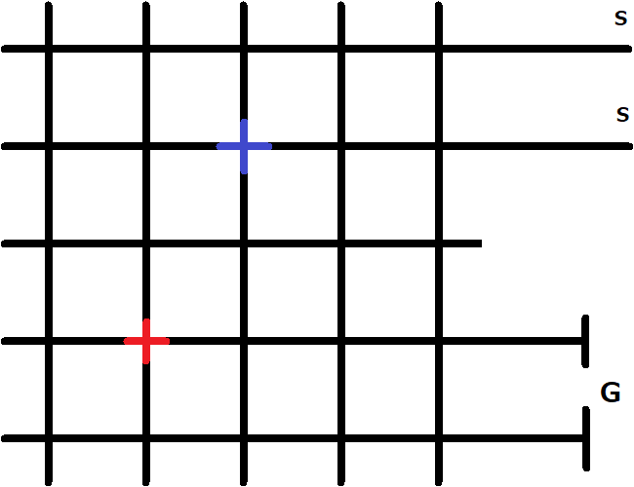
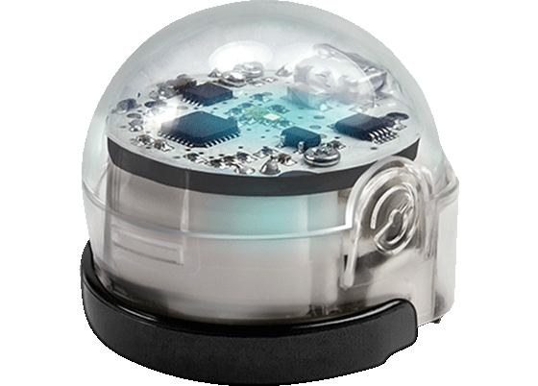
Map

Slide 5
Implementation
Initially it was considered to use A* to find best path, as some nodes has different weights. But to avoid conflicts, not always the best path can be used
Implemented BFS and DFS. Find options of paths that are ranked from shortest to longest.
Select path for each robot and check for conflicts. If there is a conflict, pick new path for the section in which conflict occurs for one of the robots. Try new paths while conflict exists.

Slide 6
Implementation
BFS, DFS and all functions related to selection of paths implemented in matlab. Output the sequence of steps for each robot. Operations result in repeated steps in the path representing their duration
Python script to generate XML file that would be loaded in OzoBlockly.

Slide 7
Results
Tested for 2 robots and 2 operations.
Non-conflict paths are found in seconds.
Optimal solution not assured.

Slide 8

Results
Video

Slide 9
Next Steps
Implement a planner for the operations sequencing. For now it was just decided manually.
Increase number of operations and robots.
Implement reactive decisions using sensors. Initial idea was have path finding algorithm embedded in ozobot, but current interface doesn’t allow that.

